Slide 1
Comfy
Snug as a bug in a rug
By
Harika Reddy Gurram: 001067184
Sriya Vaidyanathan : 001376835
Nethra Bhupathi Sudarshan Rao : 001029253
Satya Ikyath Varma Dantuluri : 001051175

Slide 2

OBJECTIVE
A web application used primarily by students to search for room postings based on their location
Obtain detailed information about the room, roommates and/or owner details.
Allows the user to add new room postings to find suitable roommates according to their requirements.

Slide 3
Technologies used
MongoDB
Mongoose
Express
React, React-Redux
NodeJS

Slide 4
Functionalities/Features
New user registration and login using JWT authentication
Create new room listing by uploading image
Search room listings based on city
View listings created by the login user under 'View My Listings’
Update the listings created by the login user
Delete the listings created by the login user
Add room listings as Favorites and view them under the 'My Favorites'

Slide 5
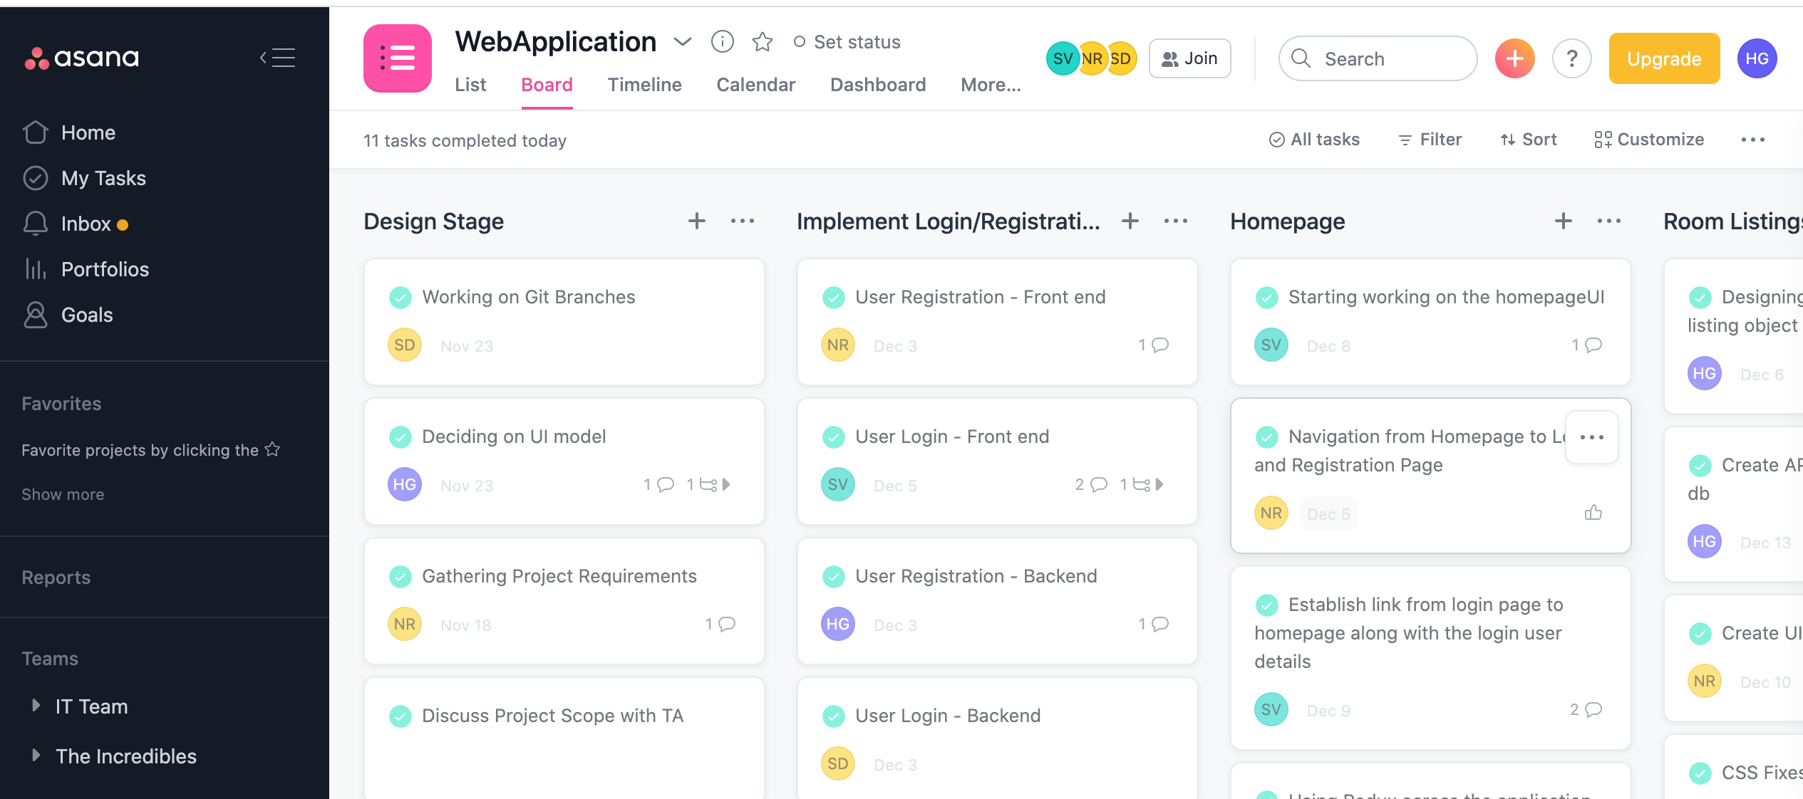
Agile METHODOLOGY

Slide 6
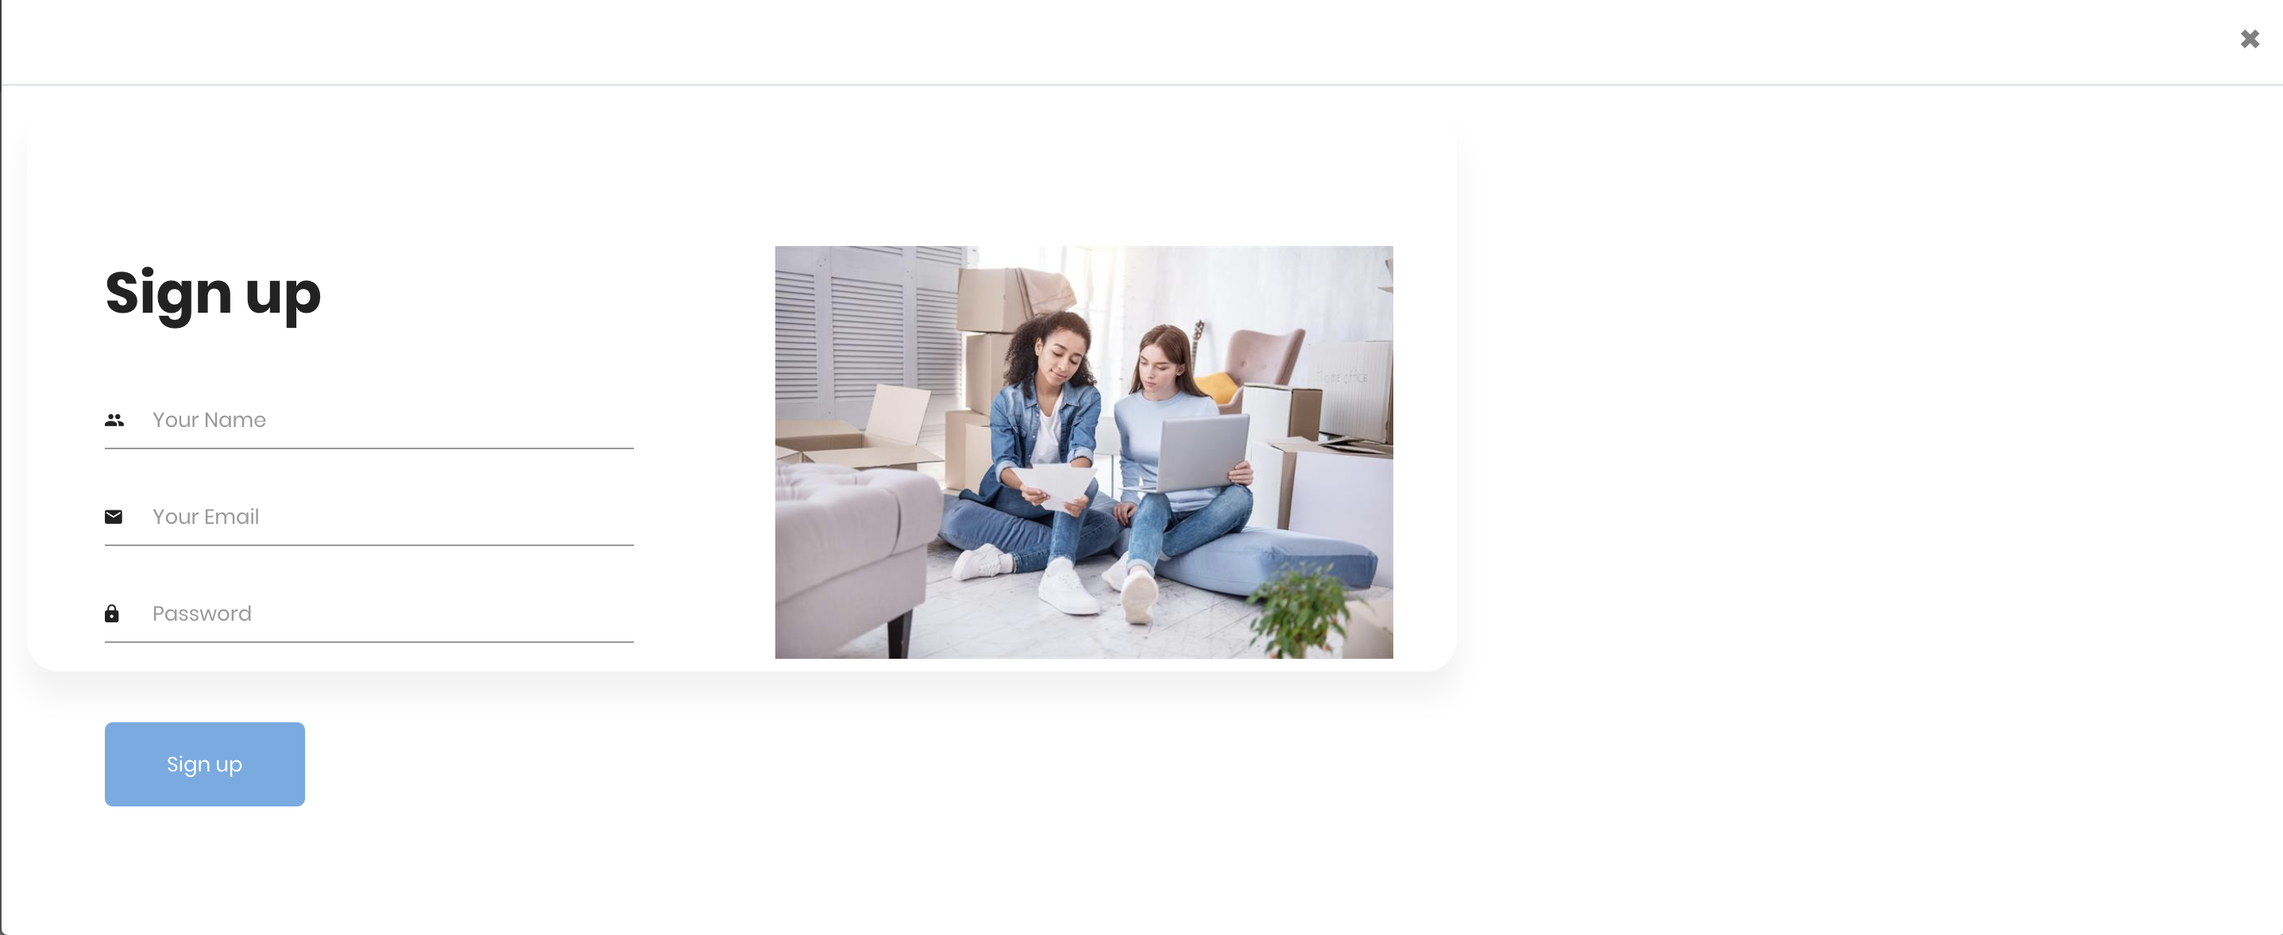
USER REGISTRATION

Slide 7
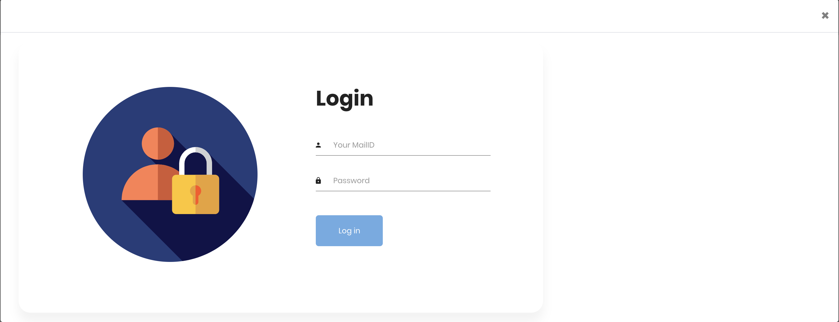
USER LOGIN

Slide 8
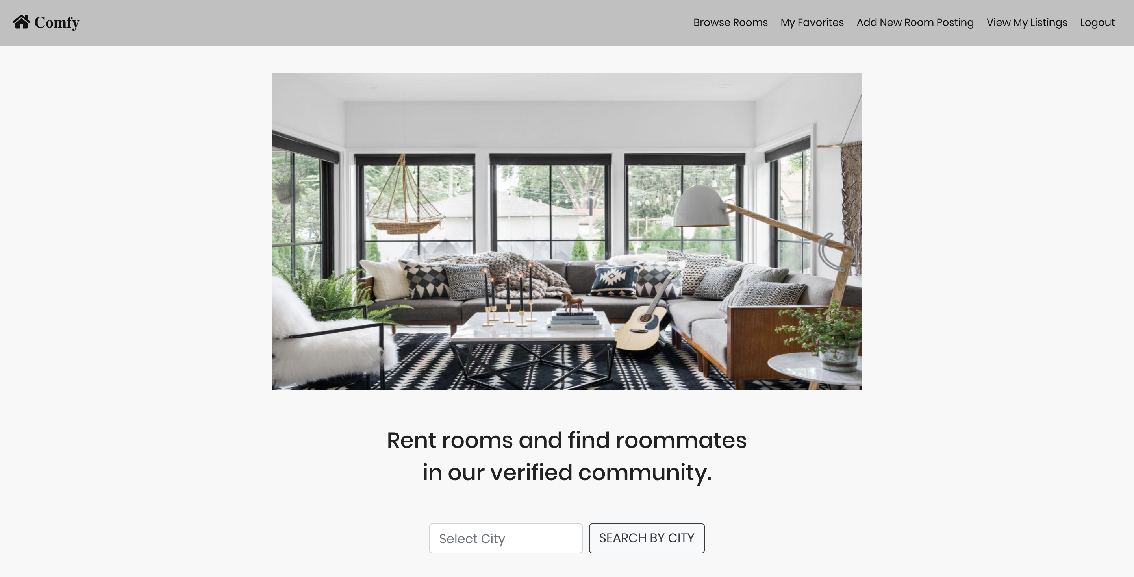
HOMEPAGE

Slide 9
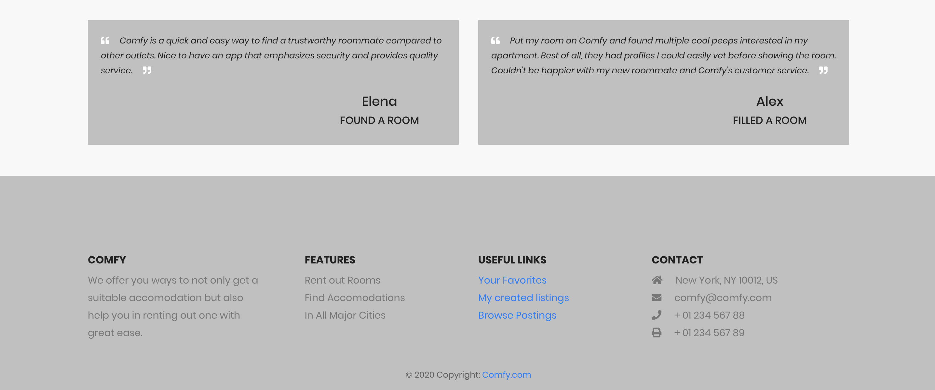
Homepage - footer

Slide 10
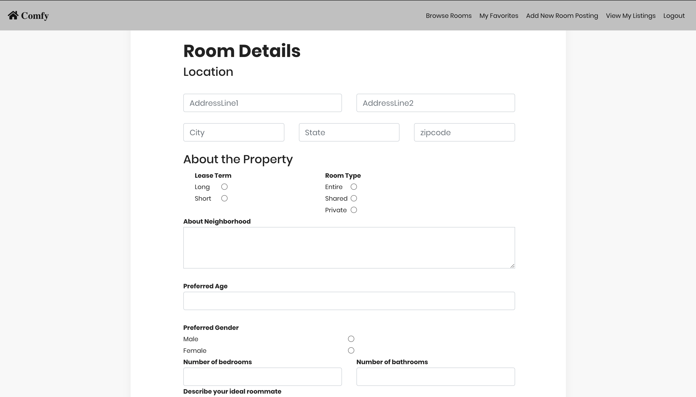
CREATE NEW POSTING

Slide 11
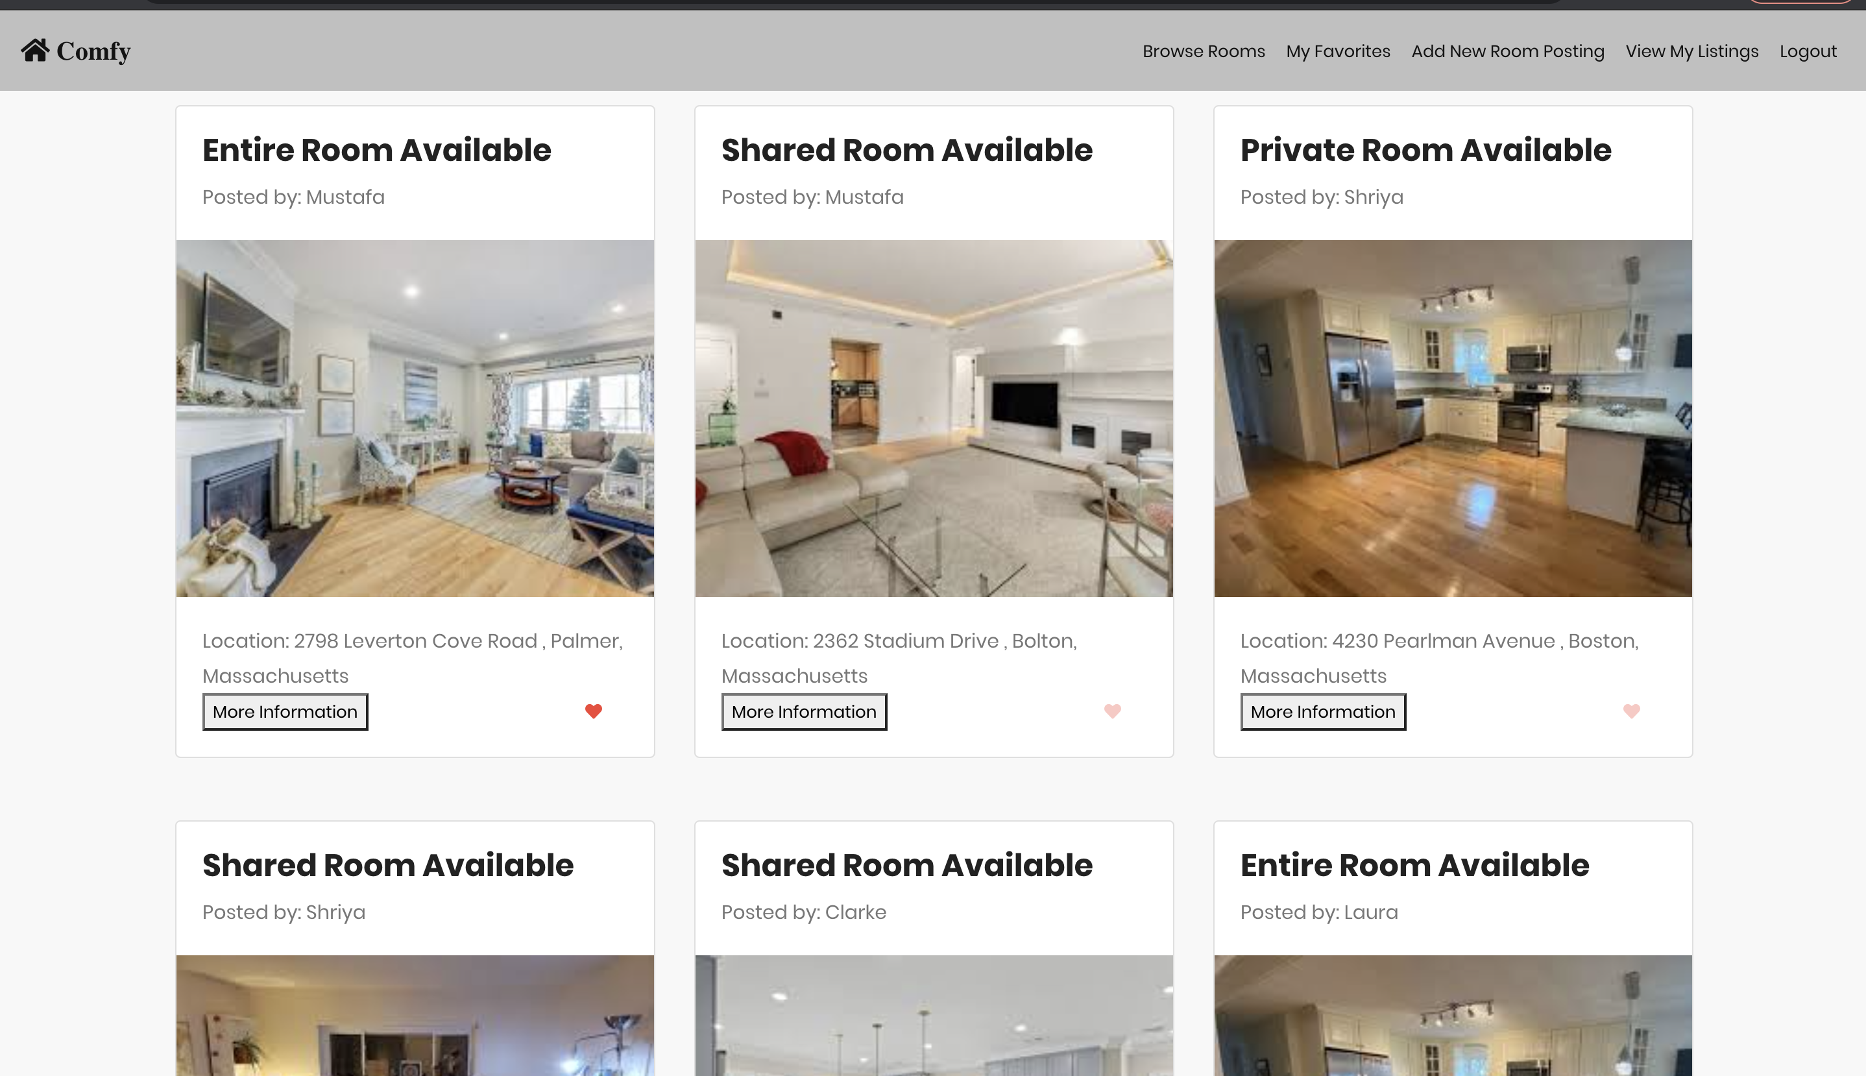
SEARCH POSTINGS

Slide 12
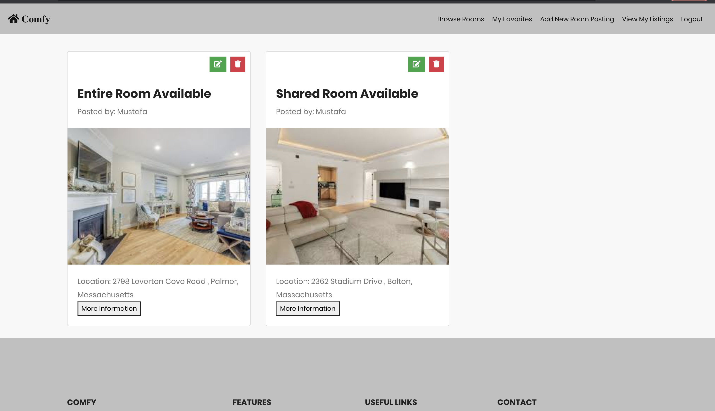
VIEW MY LISTINGS

Slide 13
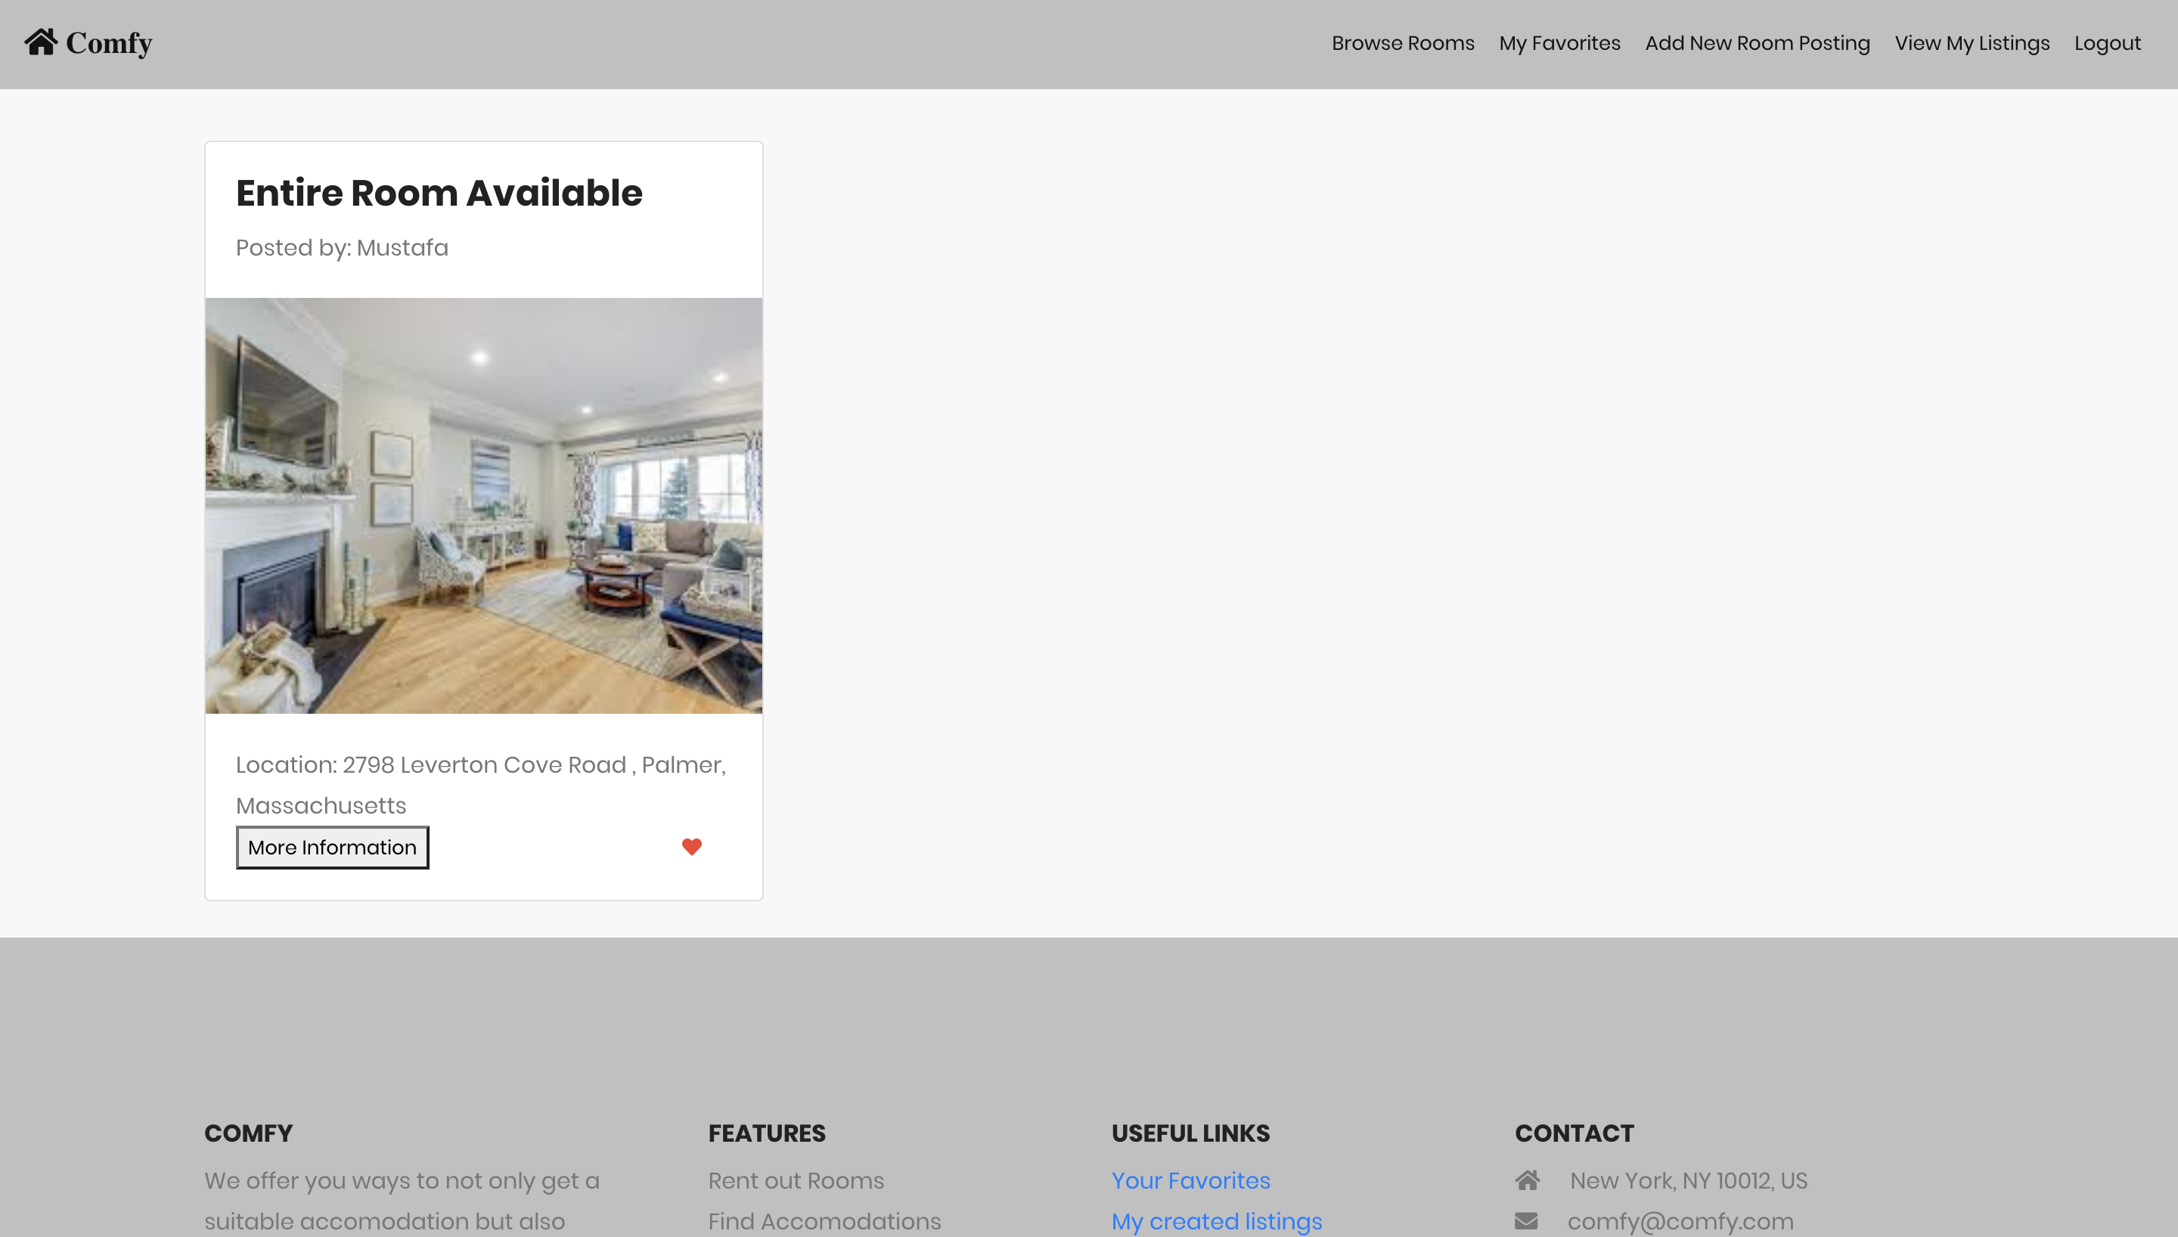
MY FAVORITES

Slide 14
FUTURE SCOPE
Ability to upload multiple images for a room listing
Additional filters to narrow the search results
Notify the Host when their listing is added to favorites by a user

Slide 15
Contributions
Shriya – HomPage, Favorites, Browse by city, Login UI and functionality
Nethra – Sign Up UI, Create Postings and styling and front-end functionality
Ikyath – Login Authentication, Middleware for user signup/login, update room posting
Harika – User Registration, Room Listing APIs, Middleware hookups for room listing and UI design for ‘More information’ modal dialog and ‘View My Listings’ view

Slide 16




Thank YOU

